Slide 2

Project 3: Law-based and document-based chatbot
Trieu Kinh Quoc | 20225524

Slide 3
Table of contents
1. Topic
2. Updated Progress
3. Upcoming Work
4. Live Demo

Slide 4
1. Topic
Purpose:
- Use of multi-agent system for helping answer user queries.
- Two specific tasks:
Answer user’s query based on references laws.
Answer user’s query based on a document.
- Build the interactive interface that user can communicate with the chatbot.

Slide 5
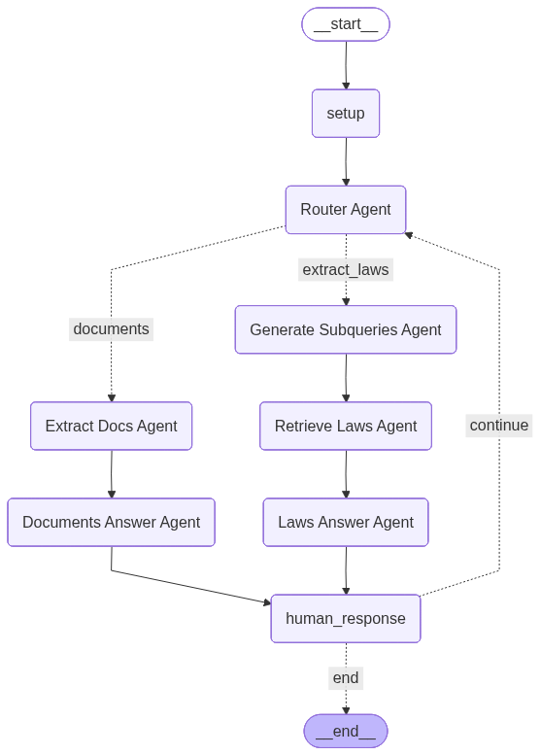
2. Updated Progress
Overall progress:
Transform from 1 agent system in Langchain to multi-agent system in Lang Graph.
Simulate this multi-agent system to see their behaviour.
Multi-agent system has memory for previous messages.
Ready to scale into more robust and reasoning system => build the completed framework, get evaluation metrics as required.

Slide 6
2. Updated Progress
Agent Used in the system:
Router Agent
Generate Subqueries Agent
Retrieve Laws Agent
Extract and Retrieve Docs Agent
Documents Answer Agent
Laws Answer Agent

Slide 7

2. Updated Progress
2.1. Router Agent
- Task: Route the query to suitable agent (documents or extract laws).
- Implementation:
Trained Neural Network model (as stated in the last report) (classifier-based router).
Input: Human Message
Output: Suitable route.

Slide 8
2. Updated Progress
2.2. Generate subqueries agent
- Task: Generate the subqueries from the user’s query for more comprehensive retriever and answer.
- Implementation:
Input: Human Message
Output: the generated subqueries.
Send the output to Retrieve Laws Agent for comprehensive retriever.

Slide 9
2. Updated Progress
2.3. Retrieve Laws Agent
- Task: Retrieve relevant laws from user and generated queries.
- Implementation:
Input: List of queries.
Output: List of relevant laws in vector database.
Send the output to Laws Answer Agent to provide context for the final answer.

Slide 10
2. Updated Progress
2.4. Laws Answer Agent
- Task: Generate the final answer based on provided context from Laws Answer Agent.
- Implementation:
Input: HumanMessage and context from Retrieve Laws Agent.
Output: Final answer to human

Slide 11
2. Updated Progress
2.5. Extract and Retrieve Docs Agent
- Task: Extract the content from PDF files. Afterwards, retrieve relevant information with the user’s query.
- Implementation:
Input: HumanMessage
Output: docs_context (information in the documents relating to the user’s query)
Send output to Document Answer Agent for final answer.

Slide 12
2. Updated Progress
2.6. Documents Answer Agent
- Task: Generate the final answer based on provided context from Extract Docs Agent.
- Implementation:
Input: HumanMessage and context from Extract Docs Agent.
Output: docs_context (information in the documents relating to the user’s query)
Provide final answer to human query.

Slide 13

3. Upcoming Work
- Add verifier and reasoning agents to the system:
Verifier Agent: put at the end of the graph, to verifies outputs of others agent to give the final answer.
Reasoning Agent: summarizing all the things that system has done to generate final answer (routing, generate sub-queries, retrievers, ….) => reasoning
- Build the completed framework of the system.
- Evaluate the model performance based on different metrics.

Slide 14
Live Demo

Slide 15
THANK YOU !

